Slide 1
IBM University Engagement Project Submission Intelligent Shopping Agent
“Exploring the Power of Agentic AI with IBM Granite and LangFlow”
Manishkumar Mathukia (Government Polytechnic, Junagadh)

Slide 2

Project Tile – Intelligent Shopping Agent
Domain of Project – E-commerce / Retail Intelligence
Faculty Name | Recent Passport Photo | Email ID | Mobile number [WhatsApp]
Manishkumar D. Mathukia |  | manishmathukia1990@gmail.com | 99989 46136

Slide 3
Problem Statement -
Problem Statement No.11: Intelligent Shopping Agent
The Challenge
Shoppers today face an overload of product options, scattered reviews, and dynamic pricing across e-commerce platforms. Finding the right product that balances price, quality, and personal preferences is time-consuming and frustrating. Traditional recommendation systems often fail to capture real-time trends, personalized needs, or contextual factors like urgency, budget, or sustainability. The challenge is not just to recommend products but to act as a smart shopping companion that helps buyers make informed and confident decisions.
The Objective
Build an agentic AI shopping assistant that provides intelligent, personalized, and real-time support. The solution should:
Fuse Multisource Data: Aggregate product details, reviews, ratings, and price comparisons across multiple e-commerce sites into unified insights.
Enable Multimodal Search: Allow users to input voice queries, images (e.g., a photo of a product), or text descriptions to find best-matching products.
Create a Predictive & Agentic Layer: Suggest purchase timing (e.g., discounts, seasonal offers), recommend alternatives, and alert users about price drops or fake reviews.
Visualize Smart Shopping Pulse: Provide a dashboard summarizing comparisons, sustainability scores, trending products, and personalized shopping lists.

Slide 4
Technology Used
Tech Stack (Mandatory)
Use any one of the following approaches:
LangFlow + IBM watsonx.ai + Granite Models
IBM Cloud Agentic Lab with IBM Granite Models
Replicate with LangChain + RAG + IBM Granite Models
I used LangFlow + IBM watsonx.ai + Granite Models

Slide 5
Proposed Solution -
Proposed Solution: Agentic AI-Powered Smart Shopping Assistant
Develop an AI-powered Smart Shopping Assistant using LangFlow and IBM watsonx.ai with Granite-4-H-Small to provide intelligent product comparison, review analysis, and purchase decision support.
The system uses Agentic AI to understand user needs (budget, urgency, preferences) and deliver data-driven, consumer-protective recommendations.
Key Capabilities:
Multi-platform comparison of products using specs, price, and features
Review analysis to detect fake or biased reviews and compute trust score
Value-for-money scoring for optimized product selection
Buy vs Wait prediction based on market trends
Smart alternatives when better options exist
The system delivers a transparent, structured, and intelligent shopping experience to help users make better purchasing decisions.

Slide 6
Langflow component Used -
Chat Input → Interface where users enter their product query, preferences, budget, urgency, or shopping requirements for analysis and comparison.
IBM watsonx AI Agent → Processes user inputs using Granite models to analyze product details, compare options, evaluate reviews, and provide intelligent shopping recommendations.
Name of IBM Granite Model → Granite-4.0-H-Small → Fast and efficient for real-time product analysis, reasoning, review understanding, and smart purchase decision support.
Chat Output → Displays AI-generated responses such as product comparisons, value-for-money scores, buying recommendations (buy vs wait), and better alternative suggestions.

Slide 7
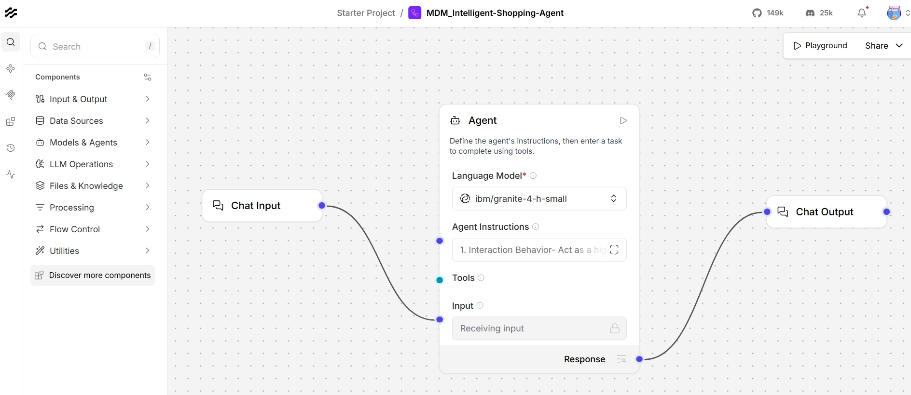
Langflow workflow -

Slide 8
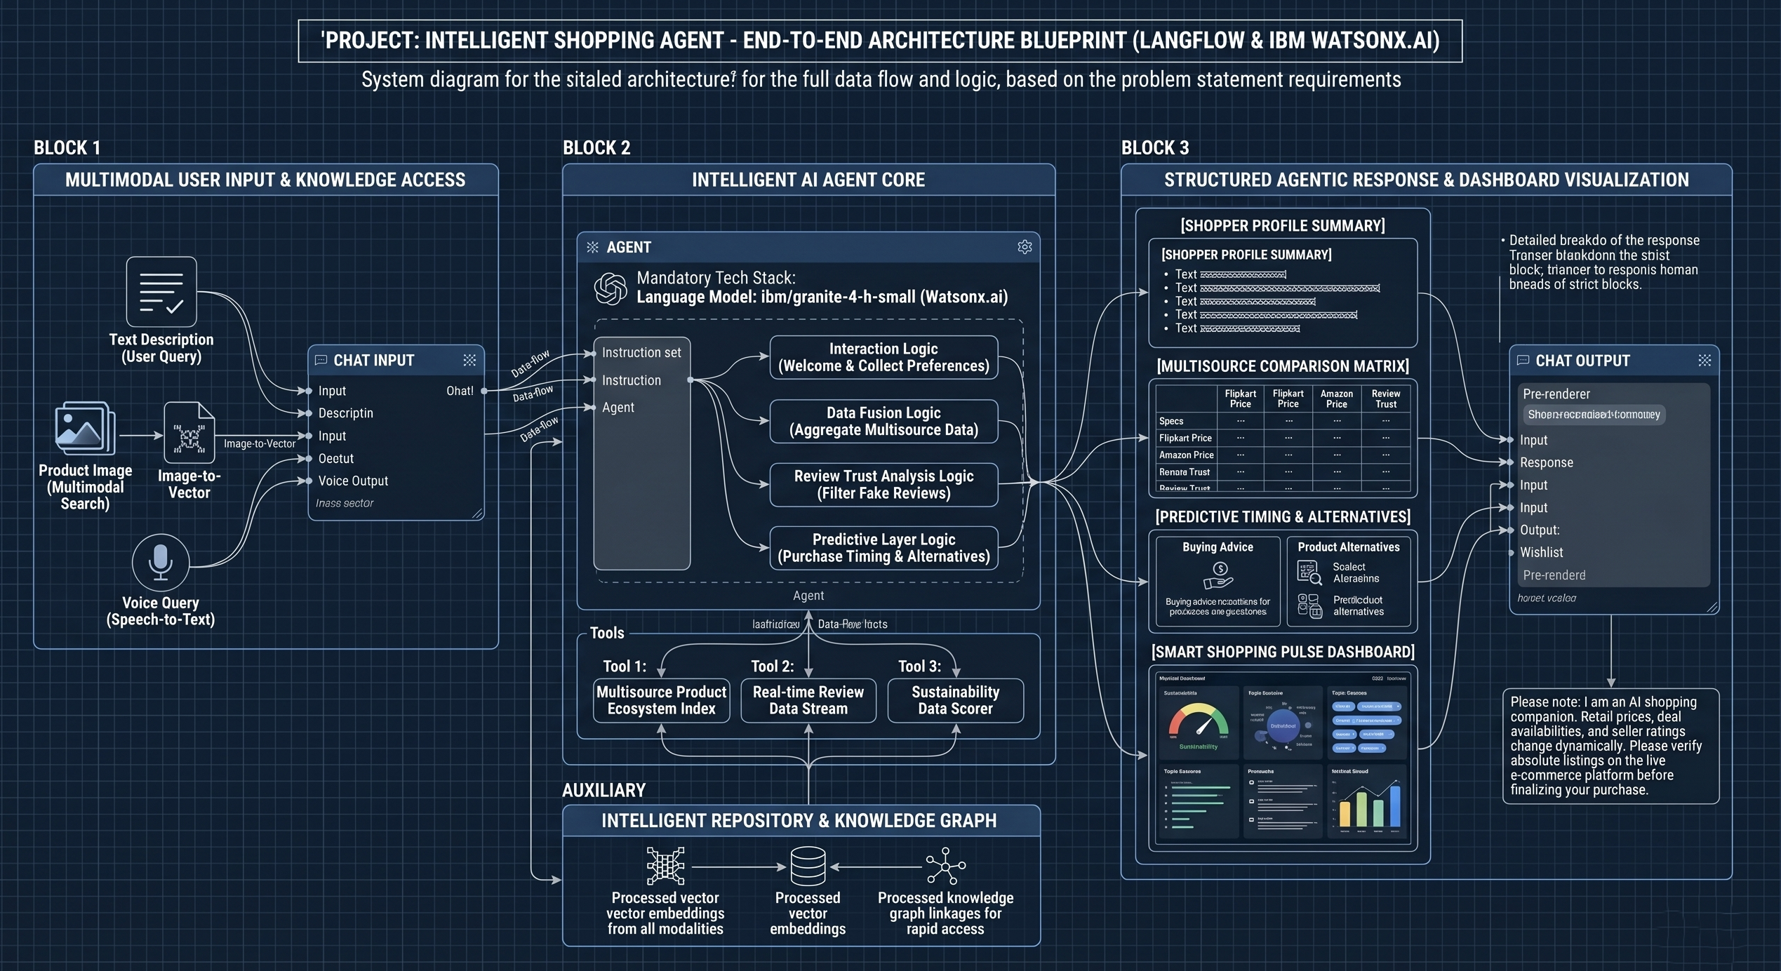
Architecture blueprint

Slide 9

Role of Agentic AI in the solution
Role of Agentic AI in Smart Shopping & Retail Intelligence Agent
Agentic AI enables the system to act as an intelligent shopping assistant that understands user needs and provides data-driven product recommendations. Powered by IBM watsonx.ai and Granite-4.0-H-Small, it analyzes products, compares options, evaluates review trustworthiness, and delivers value-for-money insights.
It also supports buy vs wait predictions and suggests better alternatives, making the system a smart, transparent, and consumer-focused decision support agent.

Slide 10
Technology Used
LangFlow platform – Used for designing and orchestrating agentic workflows visually, enabling seamless coordination between product analysis, review evaluation, comparison, and smart shopping decision-making agents.
IBM Granite Model – Granite-4.0-H-Small – Used for natural language understanding, product reasoning, review analysis, and generating personalized shopping recommendations and insights.
IBM Cloud – Provides a secure, scalable, and reliable infrastructure to deploy and manage the Smart Shopping Agent, ensuring high performance and availability for real-time user queries.
IBM watsonx.ai – Used for model deployment, prompt management, AI governance, and enabling responsible AI capabilities such as safe, transparent, and controlled product recommendation outputs.

Slide 11
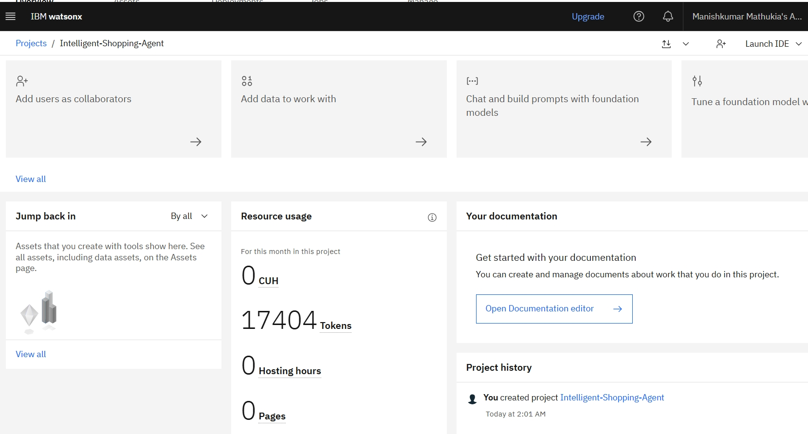
Token Usage
·
·
·

Slide 12
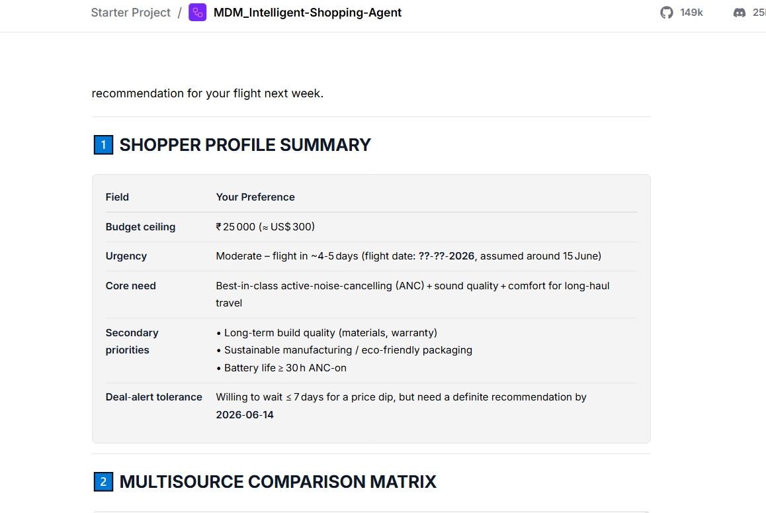
Working interface
·
·
·

Slide 13
Novelty and Uniqueness
Key Differentiators of the Smart Shopping & Retail Intelligence Agent
The proposed Smart Shopping Agent combines Agentic AI, data intelligence, and consumer protection into a single decision-support system.
Agentic AI Approach – Uses an intelligent agent instead of a simple chatbot for structured, context-aware shopping decisions. AI-Powered Product Analysis – Powered by IBM Granite to compare products, analyze specs, and evaluate features. Review Trust Detection – Identifies fake or biased reviews and improves recommendation reliability. Value-for-Money Scoring – Calculates product worth based on price, quality, and user needs. Predictive Shopping Insights – Suggests buy vs wait decisions and recommends better alternatives. IBM-Driven Architecture – Built using watsonx.ai with governance for safe and transparent AI outputs.
This makes the solution a smart, analytical, and consumer-protective shopping assistant.

Slide 14
Git Hub Link
https://github.com/manishmathukia/MDM_FDP_BVM
·
·

Slide 15
Future Scope
Multi-Platform Product Intelligence Enhancement – The system can be enhanced to integrate multiple e-commerce platforms (Amazon, Flipkart, brand websites) for deeper product comparison. This will improve accuracy in pricing trends, specifications matching, and overall decision-making.
AI-Powered Trend & Price Prediction Enhancement – The solution can be extended with predictive analytics to forecast price drops, seasonal sales, and upcoming product releases. This will help users make smarter “buy now vs wait” decisions and maximize value for money.
·
·

Slide 16


